Slide 1




Hidden Invstigations
Reverse Engineering Foundations:
ELF, PE & Static Analysis
Breaking Linux Binaries
from Scratch
HIDDEN INVESTIGATIONS
Presenter: Md. Tanjim Mahmud Tuhin
Presented to
Date: 08/08/2026
EWUCSC
Hiddeninvestigations.Net

Slide 2

Hidden Investigations
Before we begin: a story
1997
01111111 ELF 02 01 01
A locked vending machine.
No key. No manual. A student watched which coin it accepted, listened to the mechanism, and mapped it from the outside in.
↓
reverse
if (password == secret)
Software is the same. You cannot read the source, but the program still tells you everything if you know how to listen.
Every program reveals its secrets — if you know where to look.
02
Hiddeninvestigations.Net

Slide 3

Hidden Investigations
Same skill. Real stakes.
◉ Malware Analysis
⌁ Vulnerability Research
Understand what an unknown binary really does.
Find bugs without source code.
DFIR
OFFENSIVE
▣ License & Logic Bypass
◇ CTF Competitions
Understand software protections.
Build the skill by solving small challenges.
SOFTWARE SECURITY
PRACTICE
Today you will learn how all of these begin.
03
Hiddeninvestigations.Net

Slide 4

Hidden Investigations
What you will walk away with
01
Recognize the structure of a Linux ELF binary.
HANDS-ON LABS
TryHackMe
“Reversing ELF”
02
Inspect a file without running it using basic tools.
Every exercise turns one idea into something you can test.
03
Understand registers, arguments, comparisons, and jumps.
04
Build a small checker, then reverse your own binary.
The goal: learn a repeatable way to ask a binary better questions.
Hiddeninvestigations.Net

Slide 5
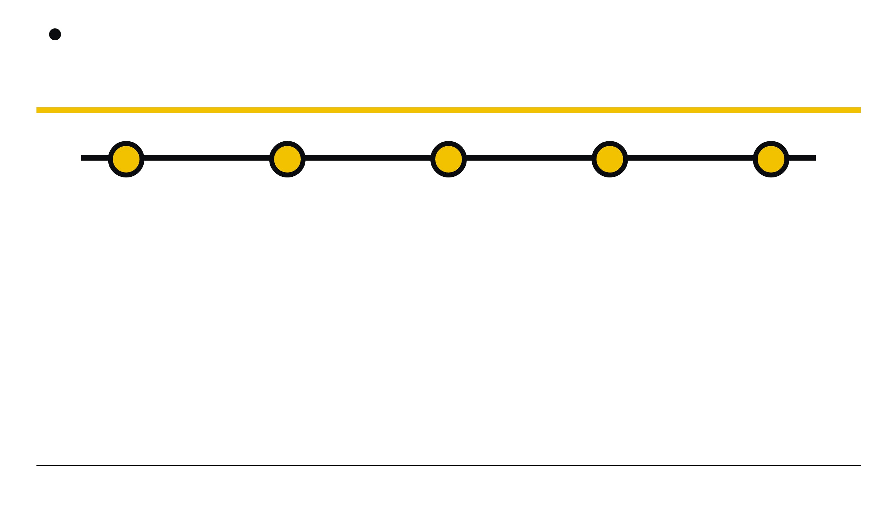
Hidden Investigations
The route from source to secrets
Fundamentals
Build Your
Own Binary
Static
Analysis
Dynamic
Analysis
Control Flow
& Logic
Start with the shape of the binary. Then learn how it thinks.
05
Hiddeninvestigations.Net

Slide 6
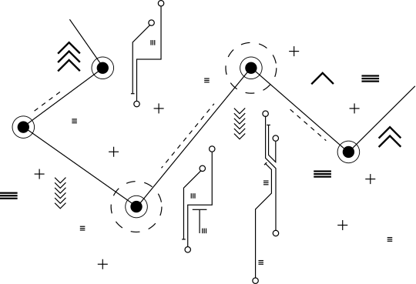
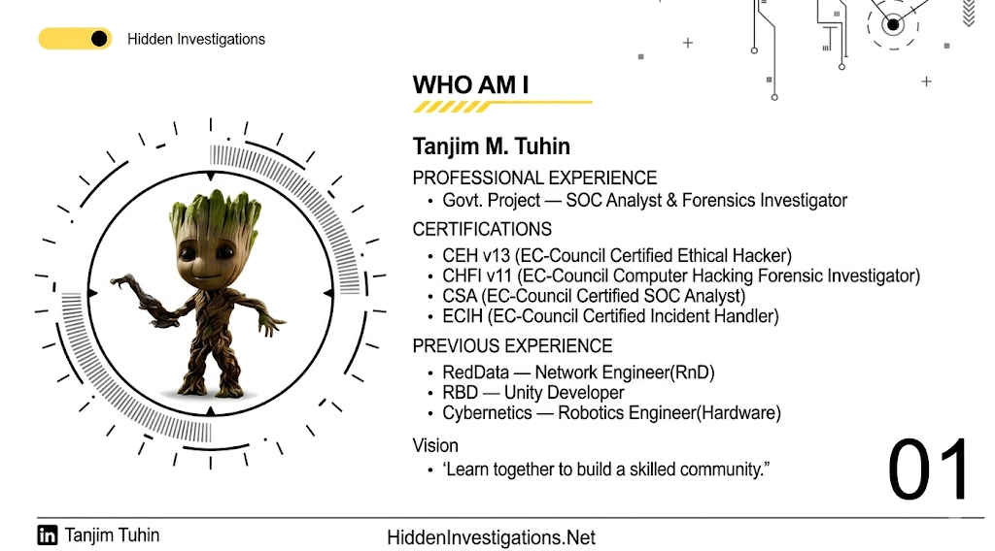


Hidden Investigations
WHO AM I
Tanjim M. Tuhin
  Founder & Lead, Hidden Investigations (est. 2022)
  Security Researcher, Yogosha Strike Force
Core Focus
  Offensive security, CTFs, Vulnerability research, Red teaming
Achievements & Awards
  1st Runner‑up — BlackHat USA CTF 2025
  2nd Runner‑up — BCS ICT Fest CTF 2025 (Bangladesh Computer Society)
  7th place — Phoenix Summit CTF 2025 (Red Team Village/Threat Sim)
Vision
  “Learn together to build a skilled community.”
01
00
Hiddeninvestigations.Net

Slide 7
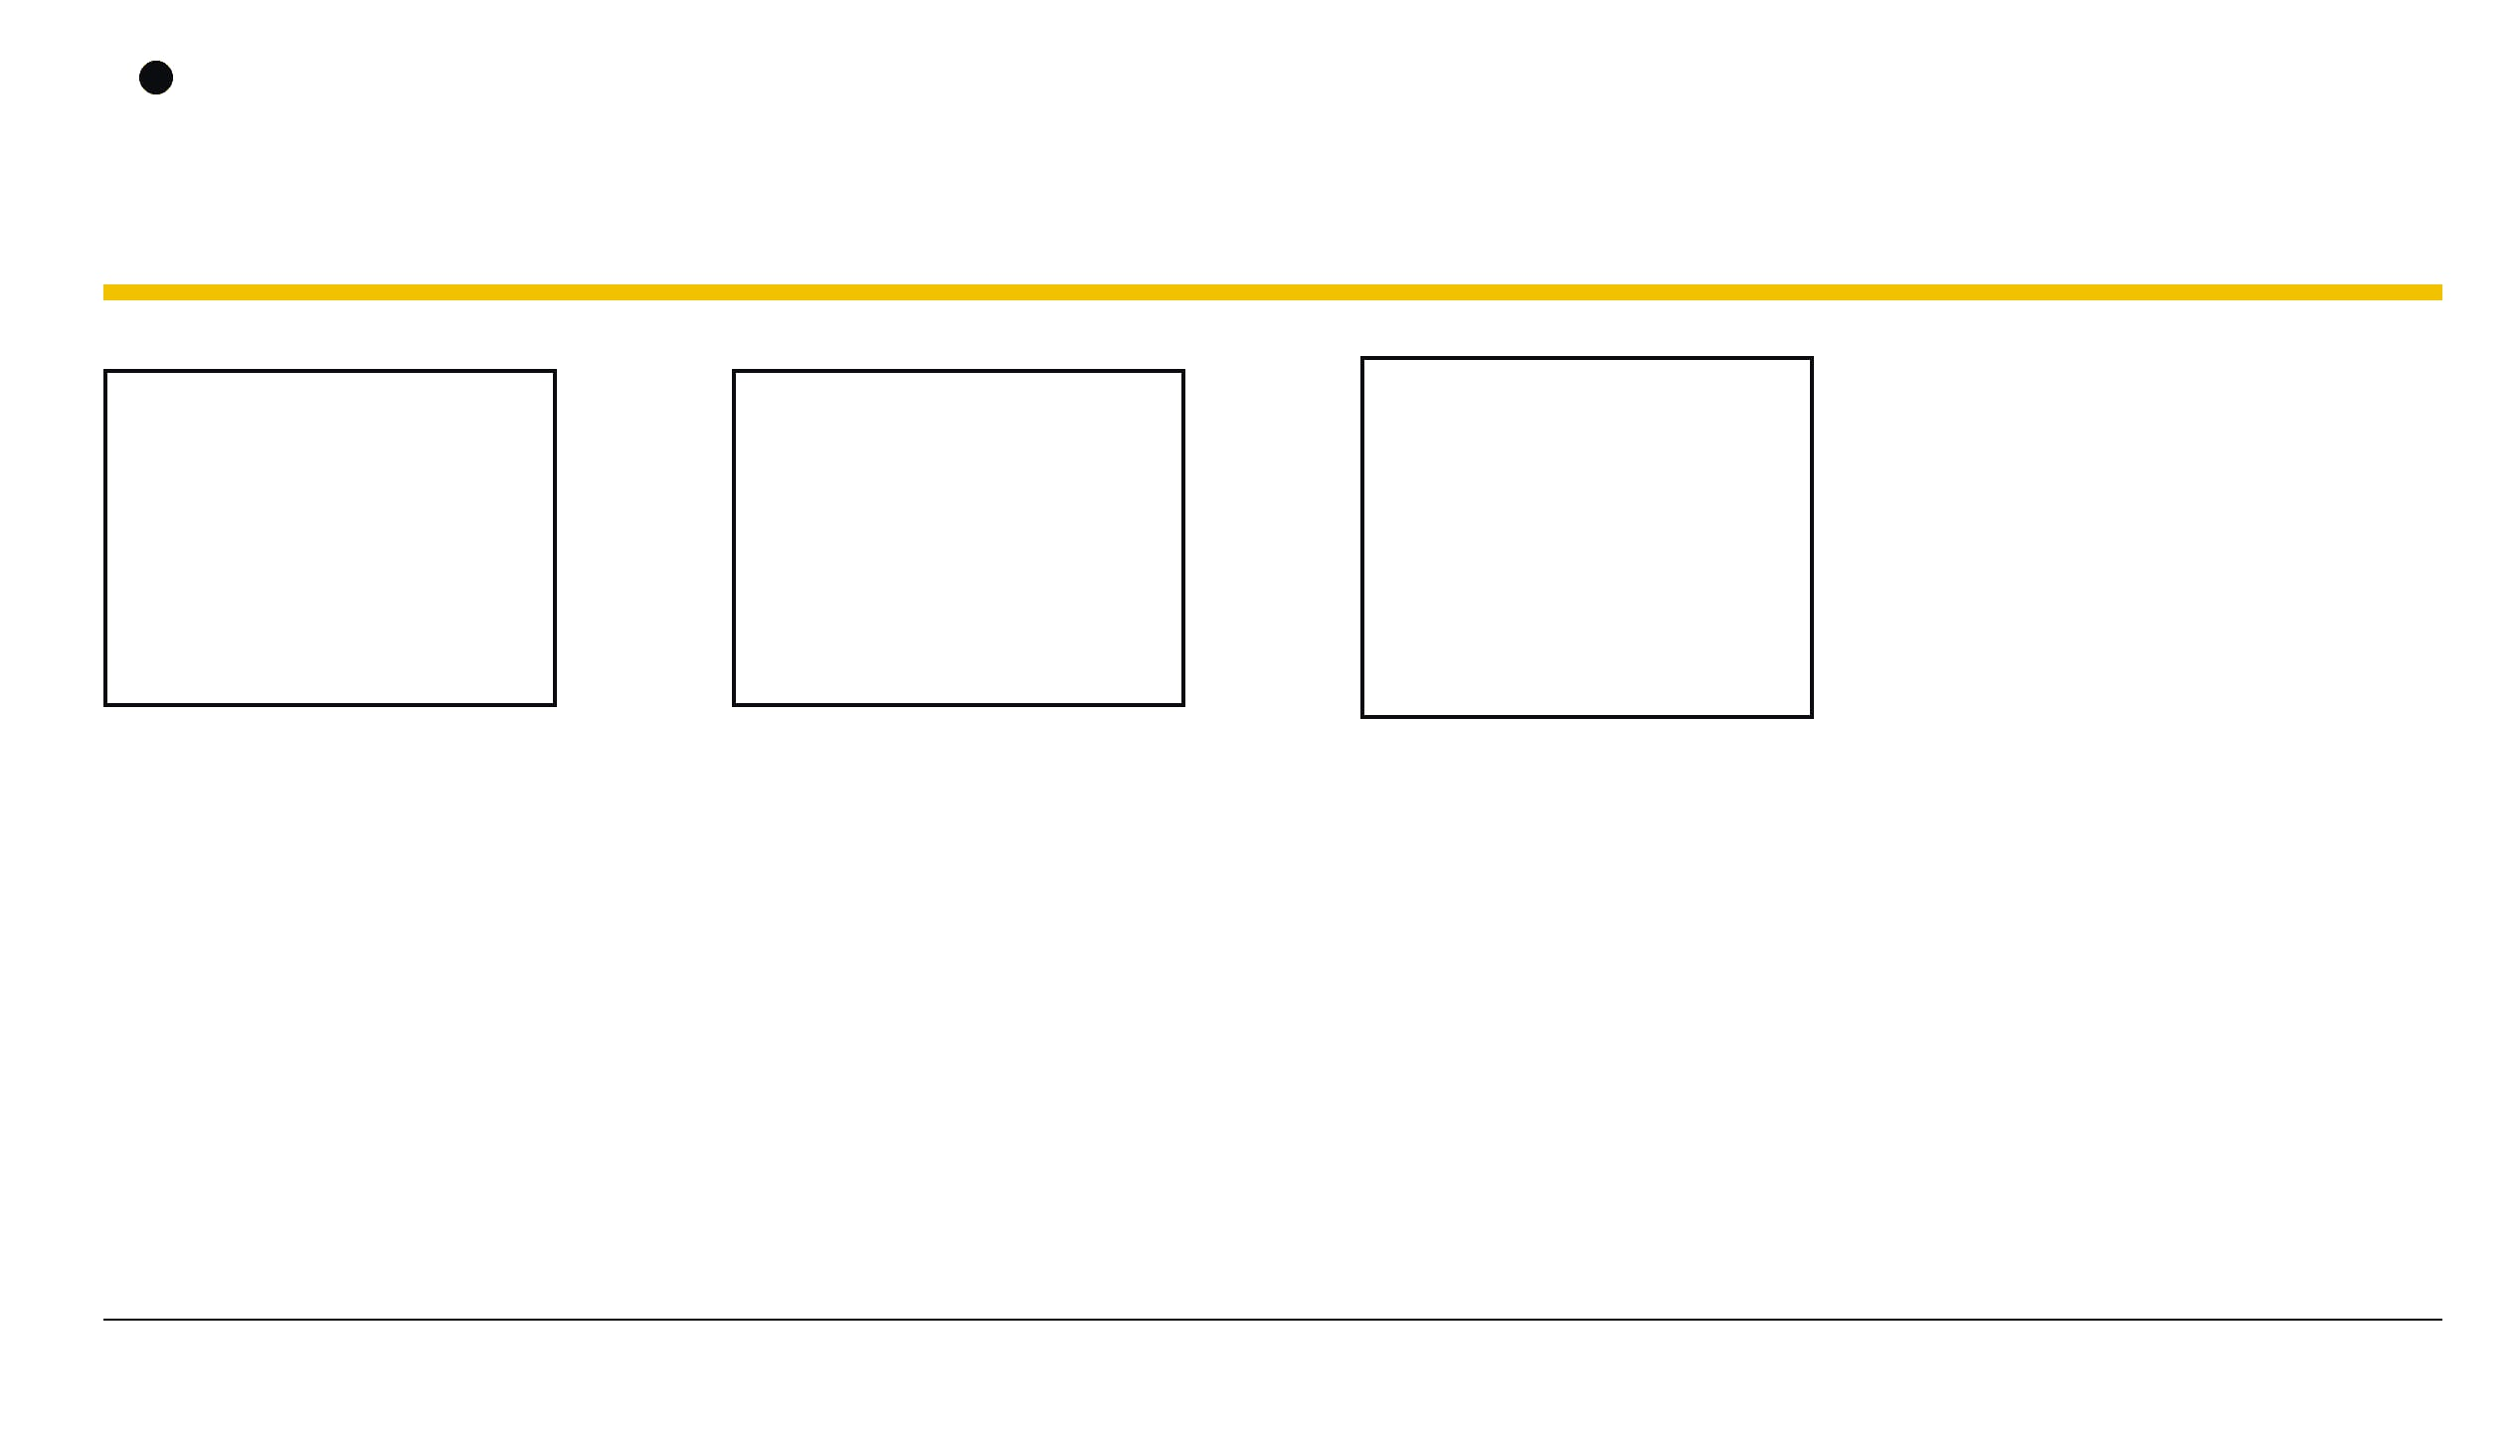
Hidden Investigations
From code to machine
STAGE 01
STAGE 02
STAGE 03
STAGE 04
.c
→
.s
→
.o
→
ELF
Source Code
Assembly
Object File
Executable
Human-readable instructions
CPU-shaped instructions
Compiled pieces, not yet linked
A runnable Linux binary
Each step removes human context — and leaves machine clues.
printf(“hello”)
06
Hiddeninvestigations.Net

Slide 8

Hidden Investigations
ELF is the binary’s container
Executable and Linkable Format
MAGIC BYTES
ELF is the standard Linux binary container. It organizes the instructions, data, and metadata a program needs to run.
7F 45 4C 46
Why begin here?
Before reading assembly, confirm what kind of file you are holding. The header gives you the first reliable clue.
45 4C 46 → E L F
The first four bytes identify the file format.
file ./binary → ELF 64-bit executable
Read the header first. It tells you what kind of puzzle you are holding.
07
Hiddeninvestigations.Net

Slide 9
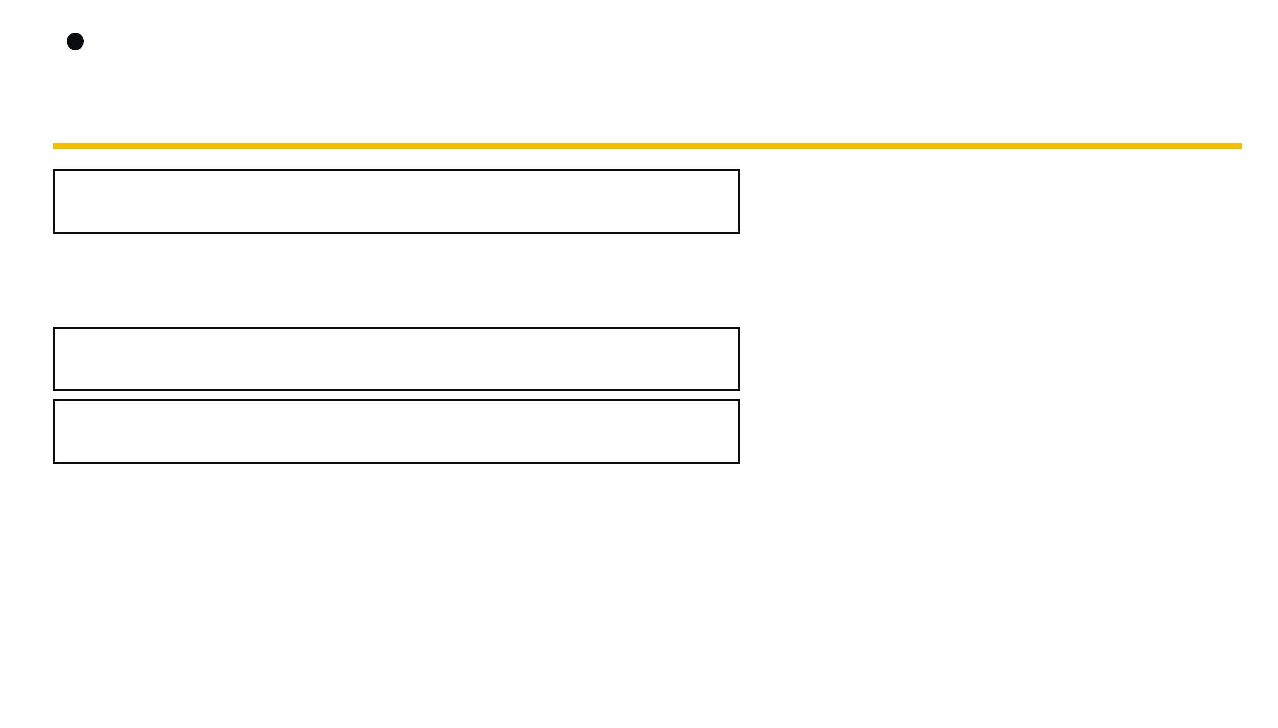
Hidden Investigations
Inside an ELF: four useful rooms
.text
The instructions the CPU executes
A SIMPLE ANALOGY
Think of sections as labeled rooms.
.rodata
Constants and strings — where clues often hide
Each room stores a different kind of information. The labels tell you where to look before you read the details.
.data
Initialized variables
.rodata is the first room beginners inspect.
.bss
Storage reserved for uninitialized data
Start with the room that stores readable constants.
Hiddeninvestigations.Net
08

Slide 10
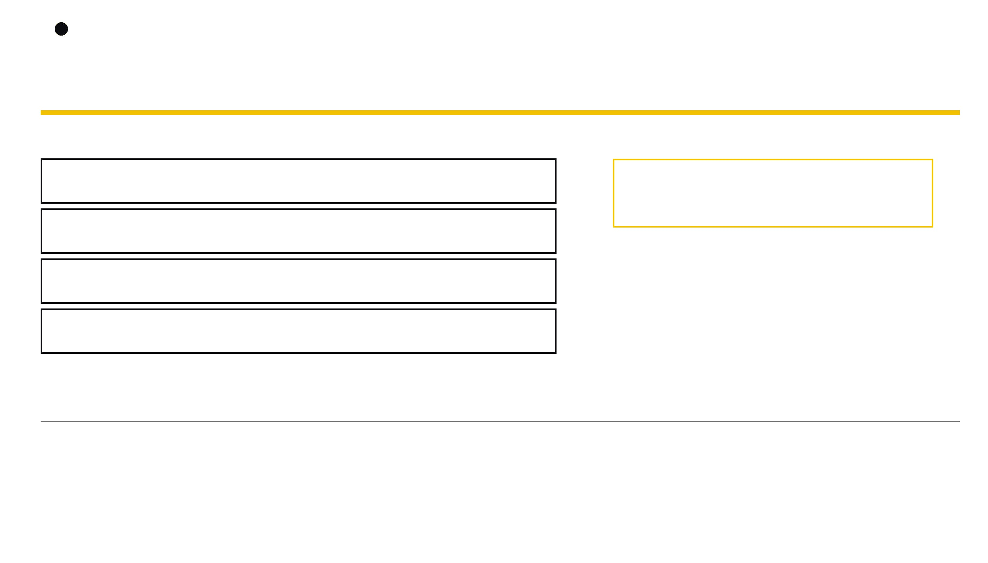
Hidden Investigations
Registers are the CPU’s pockets
The CPU keeps small, fast values close at hand.
ONE POCKET, SMALLER SLICES
RAX / EAX / AL
Return values and comparisons
RAX
64-bit register
RDI
First function argument
EAX
RSI
Second function argument
lower 32 bits
AL
RSP / RBP
Stack pointers
lower 8 bits
The name tells you how much of the pocket you are reading.
Hiddeninvestigations.Net
09

Slide 11

Hidden Investigations
Functions receive arguments in registers
1st argument
LIBRARY FUNCTION
2nd argument
VALUE 01
strcmp(input, secret)
VALUE 02
input
→
→
secret
first argument
RDI
RSI
second argument
compares two values
On common 64-bit Linux systems, the first function arguments arrive in predictable registers.
If you can read RDI and RSI, you can read the password.
Hiddeninvestigations.Net
10

Slide 12
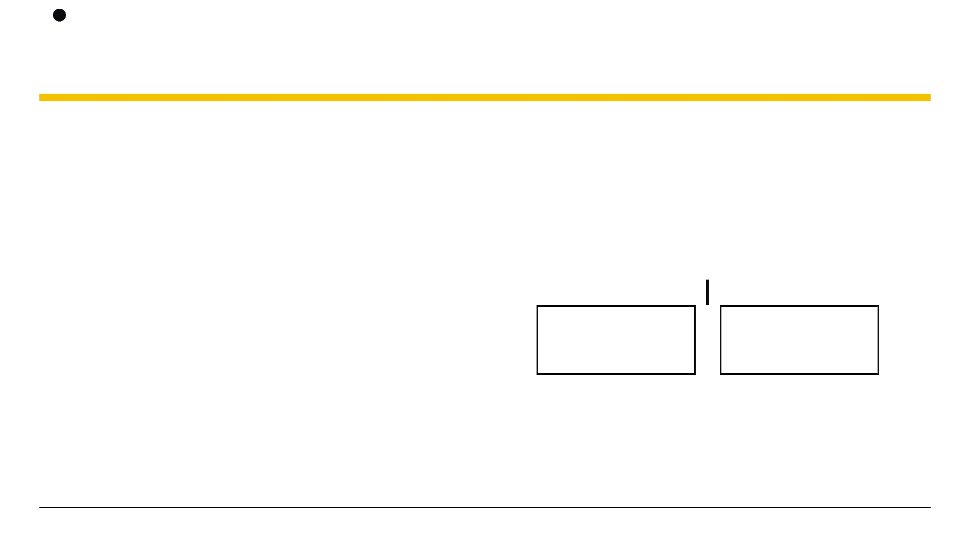
Hidden Investigations
Compare, then choose
cmp — compare two values
test — check bits or zero
je — jump when equal
jne — jump when different
The decision point
TERMINAL BLOCK / ASSEMBLY
cmp eax, 0x1
cmp input, secret
jne fail
call success
je
jne
fail:
call retry
equal → success
different → fail
The compare sets a condition. The jump chooses which path runs next.
A password check is usually a compare followed by a choice.
11
Hiddeninvestigations.Net

Slide 13

Hidden Investigations
Numbers become characters
HEX
DECIMAL
ASCII
0x31
→
49
→
"1"
compact byte notation
the same value in base ten
a character a human can read
SIGNED vs UNSIGNED
TWO’S COMPLEMENT
The same bits can represent a positive number or a negative number, depending on how the program interprets them.
A common bit pattern used to store negative integers in binary.
The same bytes can look like numbers, characters, or instructions — context tells you which.
Hiddeninvestigations.Net

Slide 14

Hidden Investigations
Reversing ELF
gcc -o binary source.c
strings ./binary
ltrace ./binary
From Building to Watching Binaries
BUILD → INSPECT → WATCH
13
Hiddeninvestigations.Net

Slide 15

Hidden Investigations
Write the lock before picking it
C SOURCE / TERMINAL BLOCK
A binary is easier to understand when you know what created it.
#include <stdio.h>
#include <string.h>
int main(void) {
char input[32];
scanf("%31s", input);
if (strcmp(input, "CHANGE_ME") == 0)
puts("Access granted");
else puts("Try again");
return 0;
}
01
Write the checker
Start with familiar source code.
02
Compile the checker
gcc -o mycrackme mycrackme.c
Turn the source into an ELF executable.
03
Reverse your own binary
Recognize how the same idea changes shape.
Build the lock first. Then learn how the binary remembers it.
14
Hiddeninvestigations.Net

Slide 16

Hidden Investigations
Lab 0 — your first binary
01
Compile it
COMMANDS / TERMINAL BLOCK
Turn the source checker into an executable.
gcc -o mycrackme mycrackme.c
02
Identify it
file ./mycrackme
Use file to confirm the binary format.
strings ./mycrackme
03
Inspect it
./mycrackme
Use strings to find readable clues.
04
Run and compare
Observe first. Explain second. Do not guess from one clue.
Compare what the source said with what the binary reveals.
You just reverse engineered yourself.
Hiddeninvestigations.Net

Slide 17
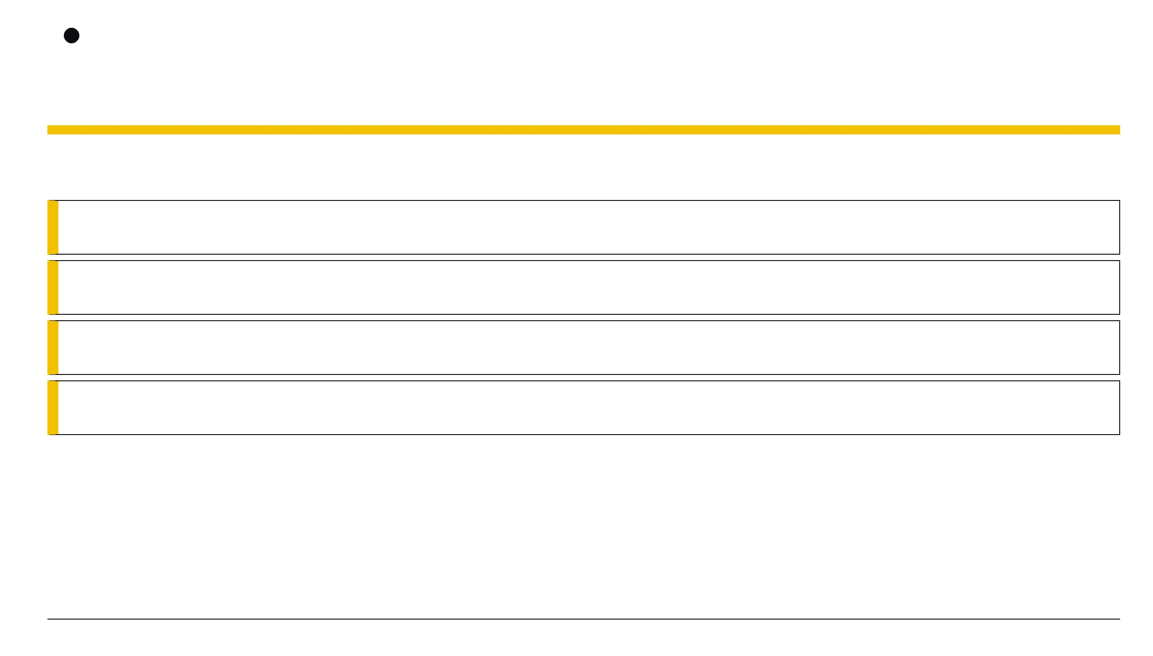
Hidden Investigations
Technique 1 — read without running
Static analysis = inspecting a program without executing it.
file
Identify the format and architecture
Tag: IDENTIFY
strings
Print readable sequences embedded in a file
Tag: QUICK WIN
rabin2 -z
List strings through the radare2 toolkit
Tag: RADARE2
objdump
Display low-level file and instruction details
Tag: DISASSEMBLE
Start with the cheapest clue before reaching for the deepest tool.
15
Hiddeninvestigations.Net

Slide 18

Hidden Investigations
When secrets are stored in plain sight
Why does strings work?
TERMINAL BLOCK / STATIC CLUE
$ strings ./binary
Constants can survive compilation.
Messages, labels, and comparison text may remain as printable bytes inside the file.
Usage: ./binary <input>
Access granted
Output is a clue, not proof.
A string may be unused, decoy text, or only one piece of the program’s logic.
Try again
[printable text only]
Encoded is not encrypted.
Base64 often looks like a long mix of letters, numbers, + /, and optional = padding.
Readable constants often live in the read-only data section.
A–Z a–z 0–9 + / =
Start with readable text. Then ask whether the program actually uses it.
16
Hiddeninvestigations.Net

Slide 19




HIDDEN INVESTIGATIONS
LAB 1: CRACKME 1, 2, 3
Run it.
strings reveals...
strings reveals Base64.
Execute the binary and observe the output.
Look for human-readable strings in the binary.
Find the encoded string and decode it.
RUNTIME
STATIC
ENCODING
$ ./crackme1
$ strings crackme2
$ strings crackme3 | base64 -d
"Always try the easy thing first."
Hiddeninvestigations.Net
17

Slide 20


HIDDEN INVESTIGATIONS
When static goes quiet
The Scenario:
You run
strings
and
rabin2 -z
, but the output
is empty or filled with junk.
Why? The developer didn't store the password as a static string. It's being built character-by-character or decrypted at runtime.
[ NO STRINGS FOUND ]
The Solution: If we can't read the secret while it's "sleeping" (on disk), we watch it while it's "awake" (running).
SWITCH TO DYNAMIC
Dynamic Analysis: The art of observing a program's behavior, memory, and interactions during execution.
Hiddeninvestigations.Net
18

Slide 21
HIDDEN INVESTIGATIONS
Technique 2: Watching library calls
The Doorway (PLT)
Most programs "borrow" functions like
strcmp
from Linux libraries (libc) rather than writing their own.
The Interception
We can stand at the "doorway" (Procedure Linkage Table) and watch every argument passed to these borrowed functions.
Tool: ltrace
A library call tracer that intercepts and records dynamic library calls as they happen.
$ ltrace ./crackme4
...
strcmp("user_input", "p4ssw0rd_in_plain_sight") = 1
...
*Note: The second argument is often the secret we are looking for.*
Hiddeninvestigations.Net
19

Slide 22
HIDDEN INVESTIGATIONS
LAB 2: CRACKME 4, 5
Crackme4
Crackme5
strings fails, ltrace wins. Intercept the
strcmp
call to find the flag.
Decoys and Lengths. Watch for
strncmp
and ignore decoy
strlen
LTRACE
calls.
FILTERING
$ ltrace ./crackme4
$ ltrace ./crackme5
"If libc does the comparing, ltrace does the cracking."
Hiddeninvestigations.Net
20

Slide 23

HIDDEN INVESTIGATIONS
The developer fights back
The Scenario
ltrace
shows nothing. No
strcmp
, no
memcmp
, no library calls
BINARY INTERNAL LOGIC
at all. The program is silent.
The Tactic
The developer wrote their own comparison logic "inline" instead of calling a shared library.
0x46
0x4C
0x41
0x47
Inline Comparison
The CPU compares each byte of your input directly against hardcoded values in its registers.
LIBC CALL PATH BLOCKED
The Result
The secret never leaves the program's internal logic. It never
crosses the "doorway" where
ltrace
is watching.
Hiddeninvestigations.Net
21

Slide 24


HIDDEN INVESTIGATIONS
Technique 3: Read the disassembly
STEP 1: OPEN & DEBUG
STEP 2: ANALYZE
r2 -d ./binary
aaa
Load the binary
Run Analysis
Load the target file into Radare2 in debug mode to allow runtime inspection.
Perform full analysis to identify functions, strings, and cross-references.
STEP 3: LIST FUNCTIONS
STEP 4: DISASSEMBLE
afl
pdf @sym.function
Find the Entry Point
Read the Code
Look for
main
or suspicious function names like
Print the disassembly of the selected function to see the raw instructions.
sym.check_password
.
Look for the Chain:
A sequence of
cmp al, 0xNN
instructions is often a password spelled out character-by-character in
Hexadecimal
.
22

Slide 25

HIDDEN INVESTIGATIONS
LAB 3: CRACKME 6
1
Locate
Find the function where the input is being checked (e.g.,
sym.check_password
).
0x31
0x33
0x33
0x37
2
Collect
Identify the sequence of
cmp
or
mov
instructions involving hex
values.
ASCII CONVERSION
3
Convert
1
3
3
7
Take those hex bytes and turn them back into readable ASCII characters.
"When the program won't talk, read its mind."
Hiddeninvestigations.Net
23

Slide 26

HIDDEN INVESTIGATIONS
Technique 4: Follow the logic
Beyond Passwords
Hidden Paths
Control Flow
Sometimes the goal isn't a string, but a specific path through the code.
Developers often leave "backdoors" or hidden menu options for testing.
By reading disassembly, we map out every
if/else
branch (jumps).
Enter Choice
NORMAL
SECRET: 0X1337
Option 1, 2, 3
FLAG / BACKDOOR
Hiddeninvestigations.Net
24

Slide 27

HIDDEN INVESTIGATIONS
When math becomes the lock
WRAPAROUND
Integer Overflow: Occurs when a program stores a value larger than its capacity.
Integer Overflow Visualized
The 32-bit Limit: Signed integers max out at 2,147,483,647.
The Wraparound: Adding 1 to the max value flips it to -2,147,483,648.
-2,147,483,648
+2,147,483,647
Logic Flaw:
Programs using
atoi()
Max Value + 1 = Min Value
for input conversion are prime targets for this bypass.
"THE BUG ISN'T IN THE PASSWORD. IT'S IN THE ARITHMETIC."
25
Hiddeninvestigations.Net

Slide 28

HIDDEN INVESTIGATIONS
Lab 4: Crackme 7 & 8
Crackme 7: Hidden Logic
Crackme 8: Integer Math
Find the secret menu
Defeat the comparison
Use
pdf @main
in radare2 to find a branch that isn't
Identify the variable type and its maximum value. Provide a specific input that causes an overflow to bypass a "must be less than" security check.
mentioned in the program's output. Look for conditional
jumps (
je
,
jne
) that lead to unreferenced code blocks.
LOGIC FLOW
ARITHMETIC
# Commands for Lab 4
r2 -d ./crackme7
aaa; afl; pdf @main
./crackme8 [large_value]
26
"LOGIC FLOWS WHERE THE CODE GOES — FOLLOW THE BRANCHES."
Hiddeninvestigations.Net

Slide 29

HIDDEN INVESTIGATIONS
Your decision tree
START
Run strings. Found it?
YES
Success! (Done)
NO
Run ltrace. Does libc do the comparing?
YES
Read RDI and RSI
NO
Disassemble. Is it an inline cmp chain?
YES
Collect Hex Bytes
NO
Read main() flow and check arithmetic
GO
Find the Logic Bug
27
Hiddeninvestigations.Net

Slide 30

HIDDEN INVESTIGATIONS
Where to go next
x86-64 Assembly
C Internals
Master the fundamental language of the CPU to understand exactly how instructions manipulate data.
Understand how high-level C code is structured in memory, including the stack, heap, and pointers.
Ghidra & Decompilers
More CTF Rooms
Move beyond assembly by using professional tools to translate binary code back into readable pseudo-code.
Practice your skills on TryHackMe, HackTheBox, and PicoCTF to encounter more complex binary challenges.
28
STATIC FIRST. DYNAMIC WHEN STATIC GOES QUIET.
DISASSEMBLE WHEN NOTHING ELSE TALKS.
Hidden Investigations | Hiddeninvestigations.Net

Slide 31


Slide 32
Hidden Investigations
Thank You
Learn together, to build a skilled community
Hiddeninvestigations.Net
hi@hiddeninvestigations.net

